Slide 1
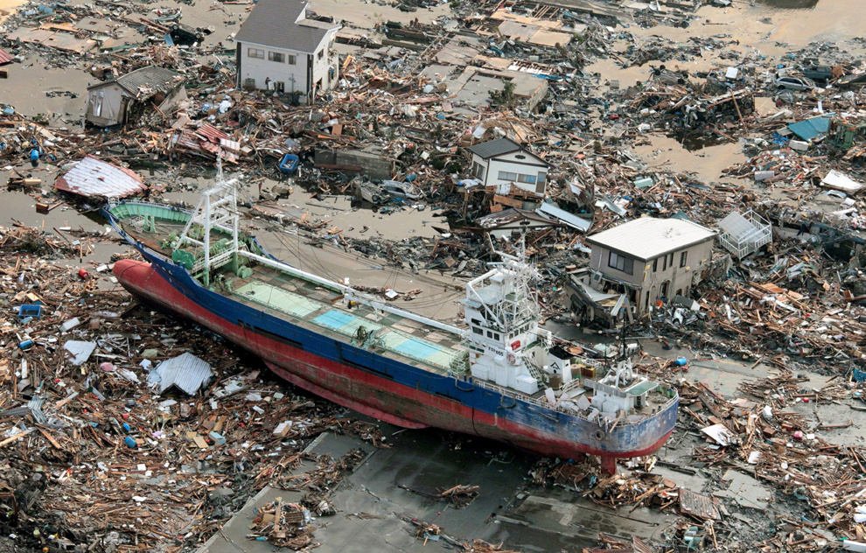

EARTH 270 – DISASTERS AND NATURAL HAZARDS (v. 2018)
Kensennuma City, Miyagi Prefecture , Japan, March 2011
PROFESSOR S.G. EVANS, PhD, PEng (Room 303, Earth Science and Chemistry (ESC) Building)

Slide 2
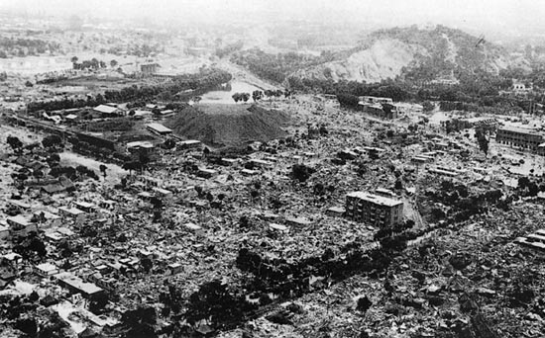
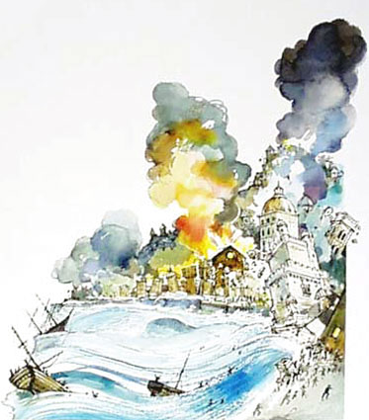
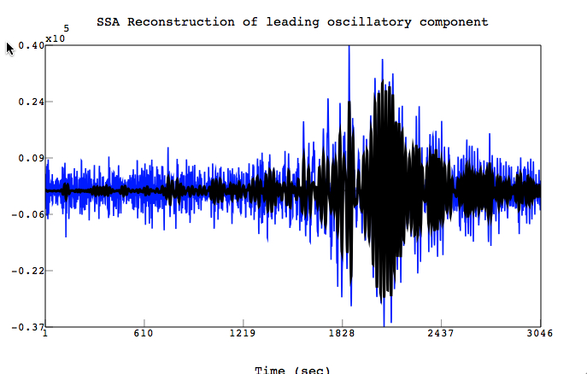
EARTHQUAKES 2
Tangshan, China 1976
Lisbon 1755
Earthquake is a sudden slip on a fault (or a new rupture of the crust ) and the resulting ground shaking caused by the radiated seismic energy generated by the slip (rupture) ; slip (rupture) usually caused by tectonic forces but may be caused by magma movement in the vicinity of volcanoes or other sudden stress changes in the crust

Slide 3
EARTHQUAKE
RESISTANCE
DAMAGE/LOSS

Slide 4
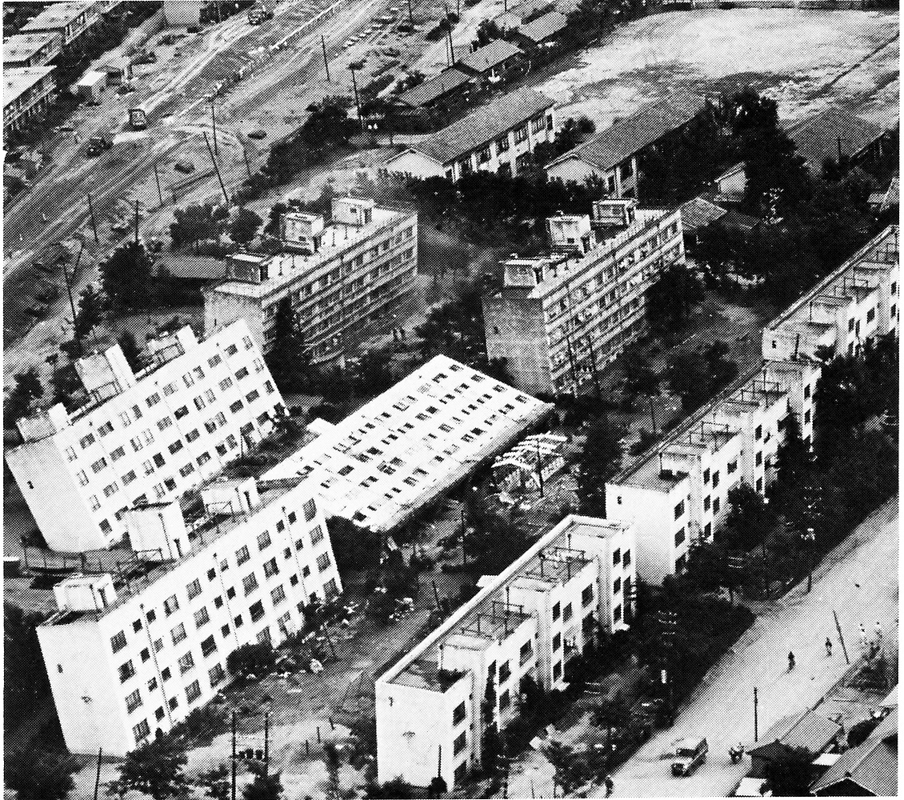
SECONDARY EFFECTS 1 - LIQUEFACTION
ENGINEERING GEOLOGY OF EARTHQUAKES
Foundation failure in silts and sands due to liquefaction in 1964 Niigata Earthquake, Japan
Niigata, Japan, 1964

Slide 5
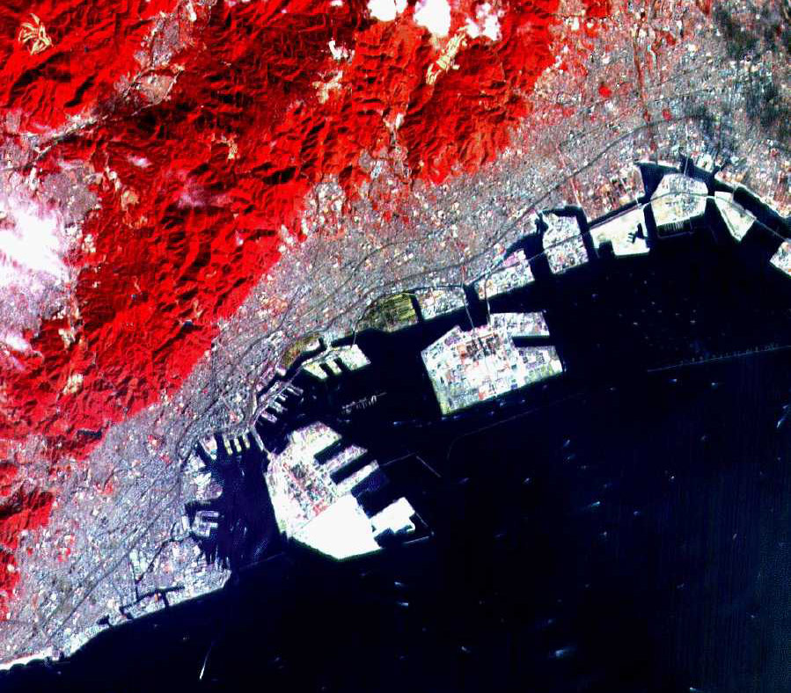
Earthquake liquefaction of artificial soils :
Example of man-made islands, Kobe Harbour, Japan.
Extensive liquefaction occurred during 1995 Kobe earthquake.
Material is poorly graded sand, predominantly crushed granite from local quarries

Slide 6
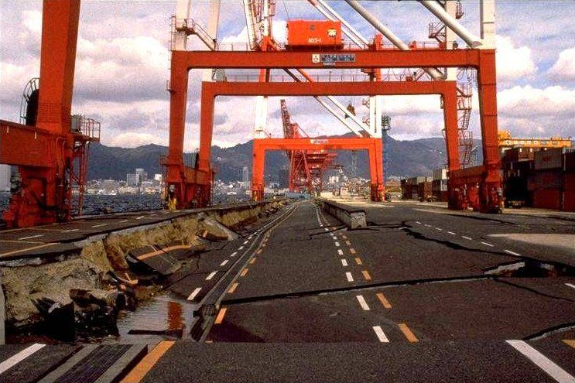
1995 Kobe Earthquake; Liquefaction of artificial islands and destruction of port facilities

Slide 7
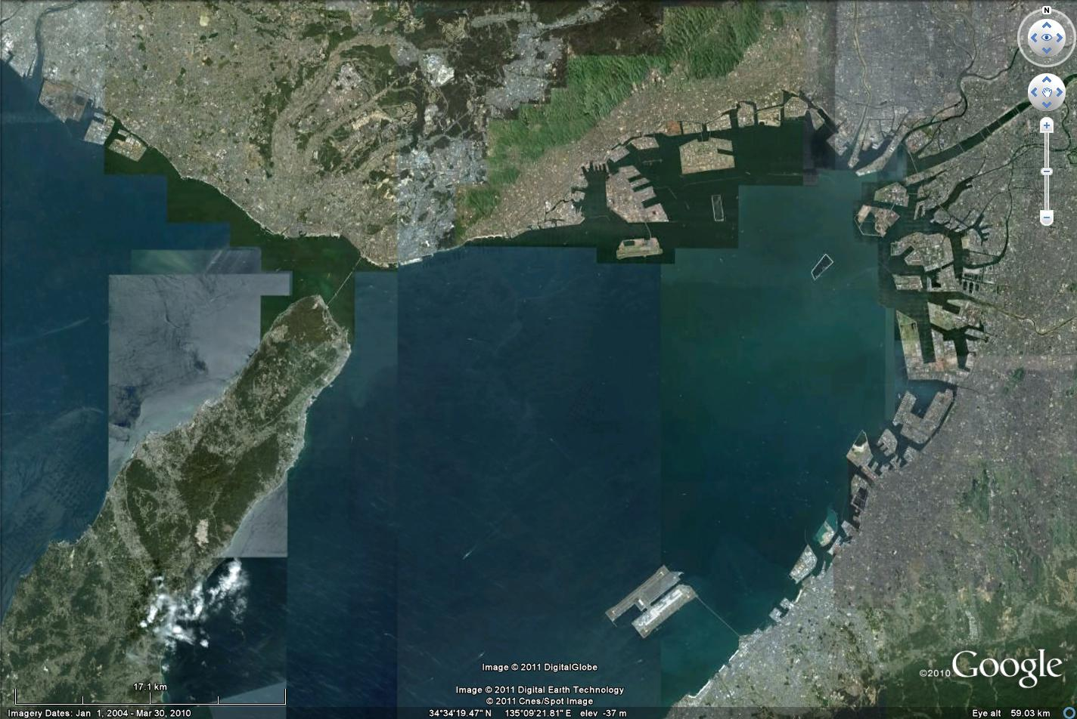

Slide 8
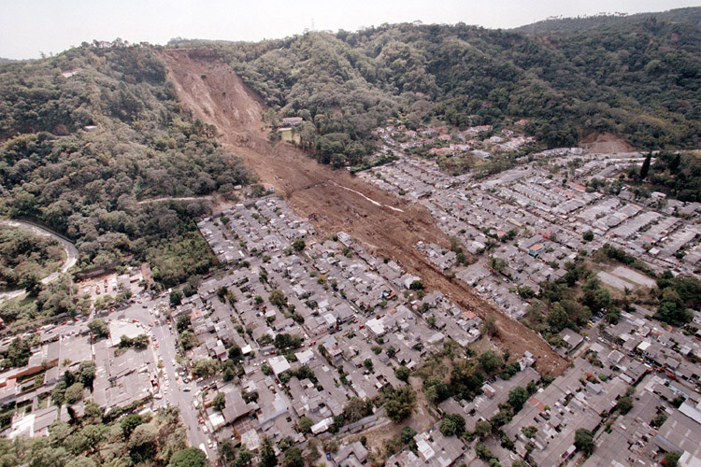
SECONDARY EFFECTS 2 – LANDSLIDES
QUANTIFICATION OF LANDSLIDE DESTRUCTIVENESS
2001 Las Colinas landslide, El Salvador (ca. 600 deaths) – very high impact; very small landslide

Slide 9
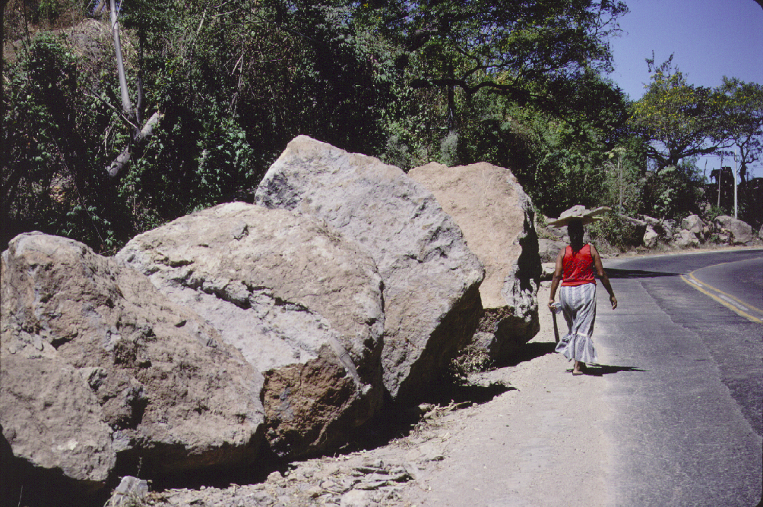
Earthquake-triggered rockfall, El Salvador, 2001

Slide 10
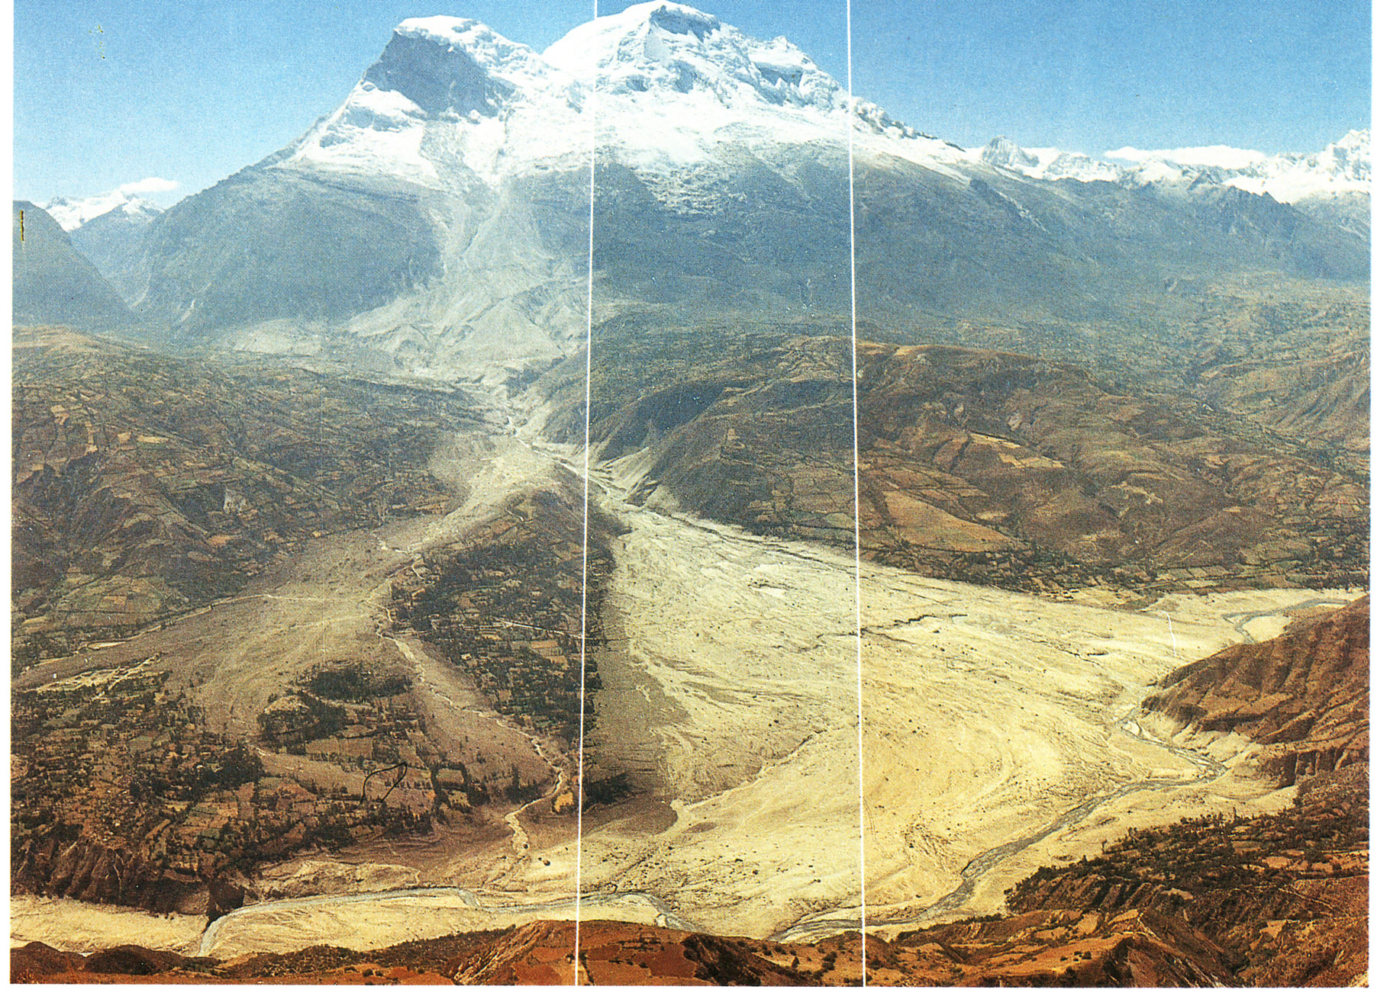
Huascaran, Peru 1970

Slide 11
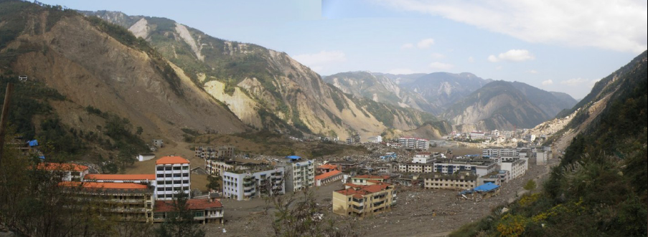
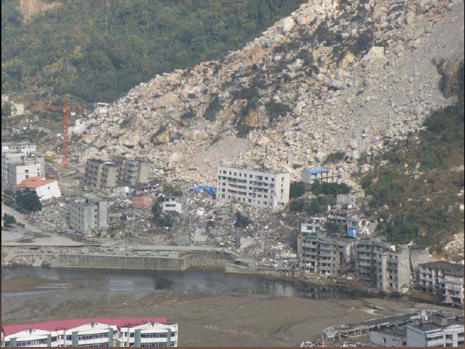
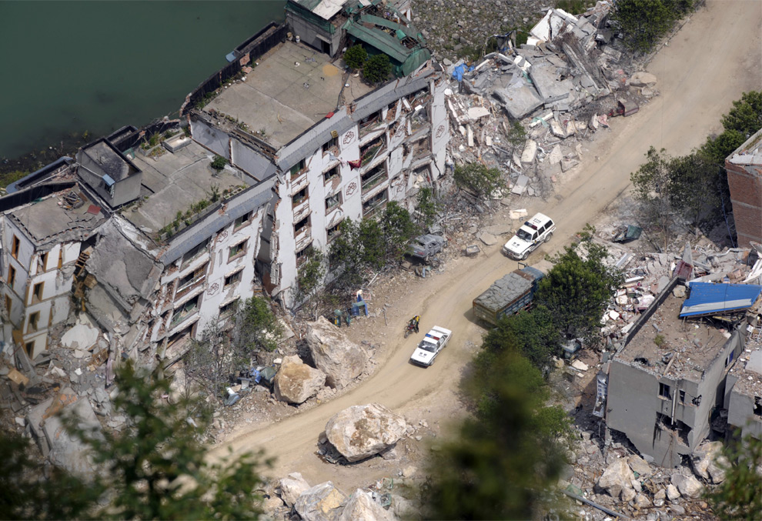
LANDSLIDES IN BEICHUAN; M 7.9 2008 WENCHUAN EARTHQUAKE, CHINA

Slide 12
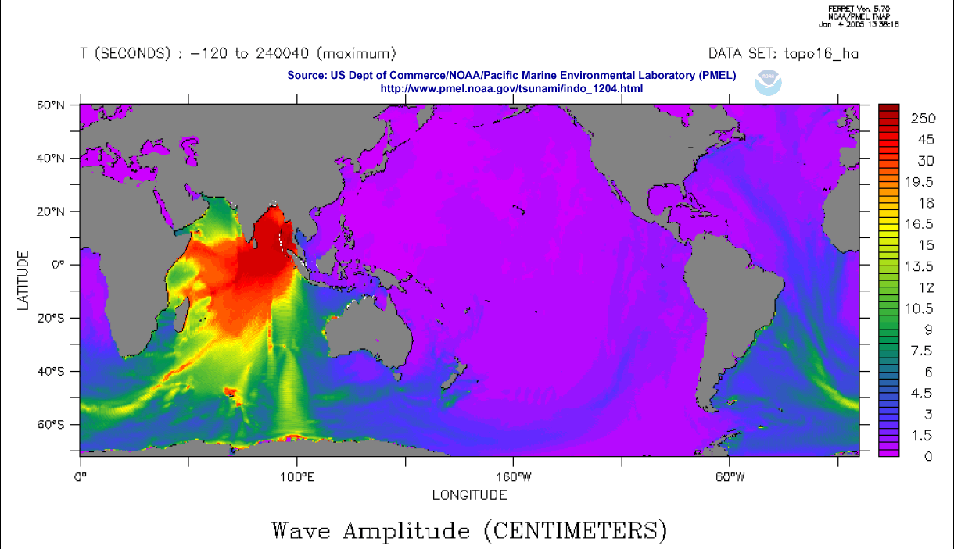
SEONDARY EFFECTS 3 - TSUNAMI

Slide 13
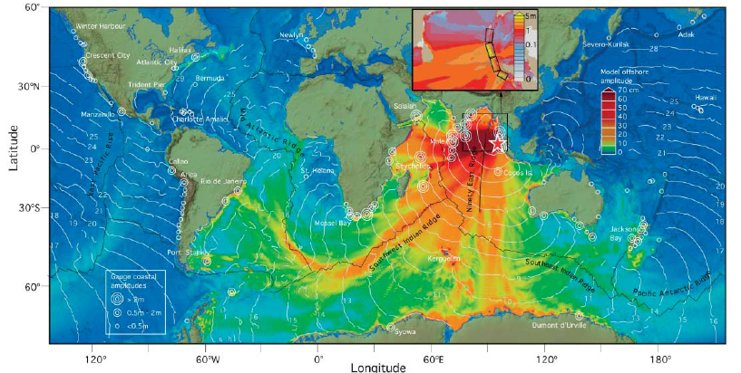
2004 SOUTH ASIAN TSUNAMI RESULTING FROM M9.$ GREAT SUMATRA EARTHQUAKE
Earthquake displacement of sea floor

Slide 14
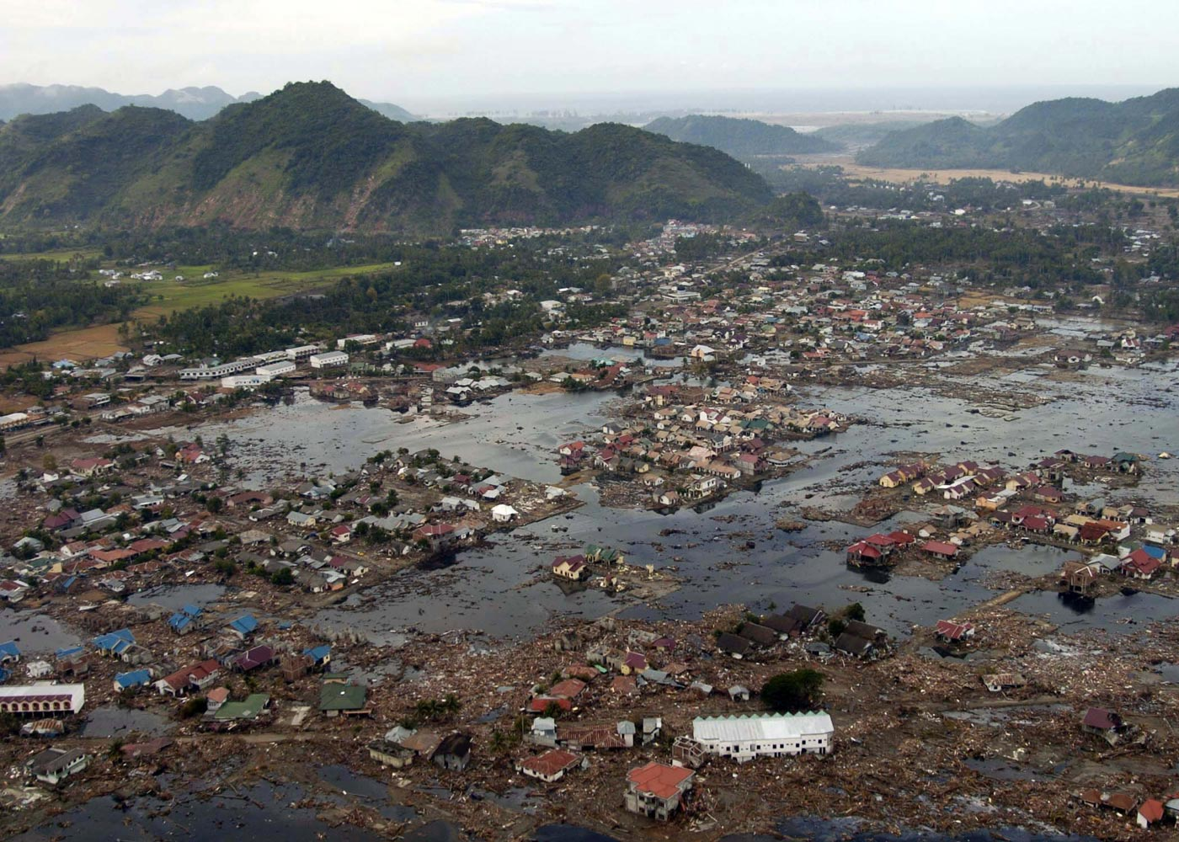
Village on the coast of Sumatra

Slide 15
EARTHQUAKE
RESISTANCE
DAMAGE/LOSS

Slide 16
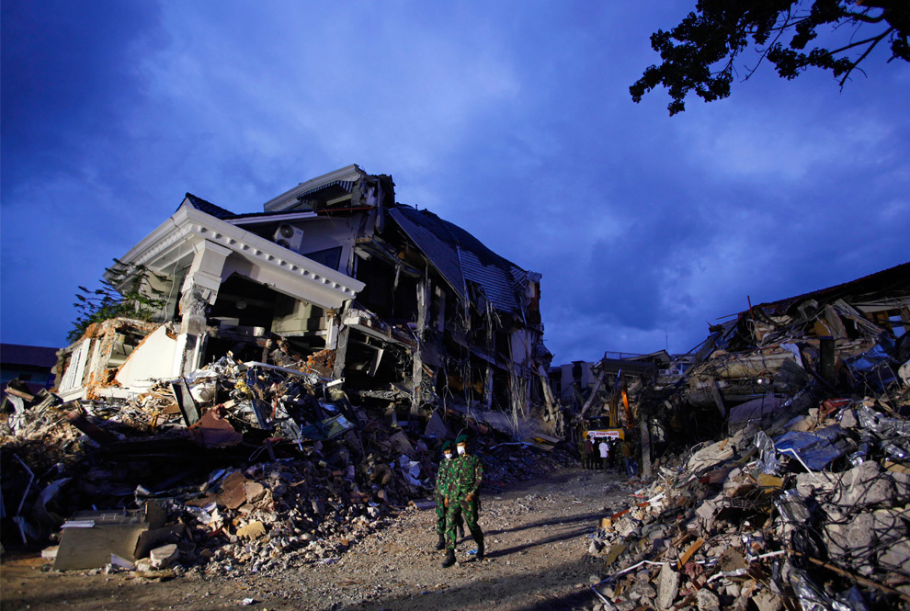
EARTHQUAKES AND SEISMOLOGY

Slide 17
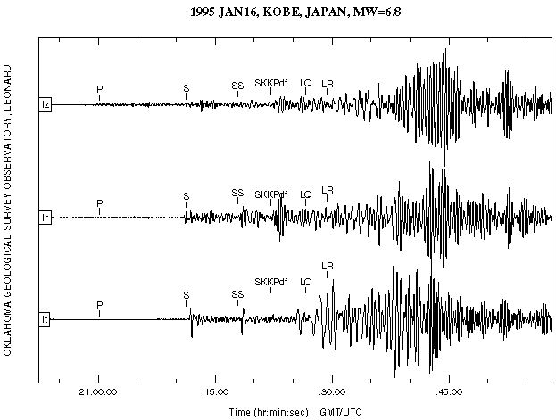
EARTHQUAKES & SEISMOLOGY
Niigata, Japan, 1964

Slide 18
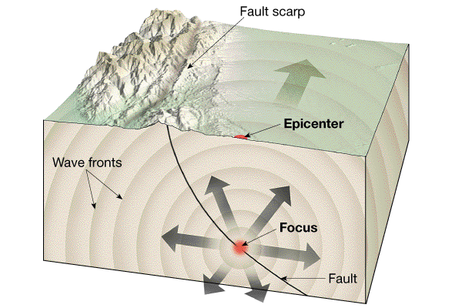
FOCUS AND EPICENTRE
When an earthquake occurs, seismic waves radiate out in all directions from the zone of energy release.
The focus (hypocenter) is the zone within the Earth where the initial slip/rupture occurs.
The epicenter is the surface location directly above the focus
Focal depth is the vertical distance between the focus and the epicenter
1

Slide 19
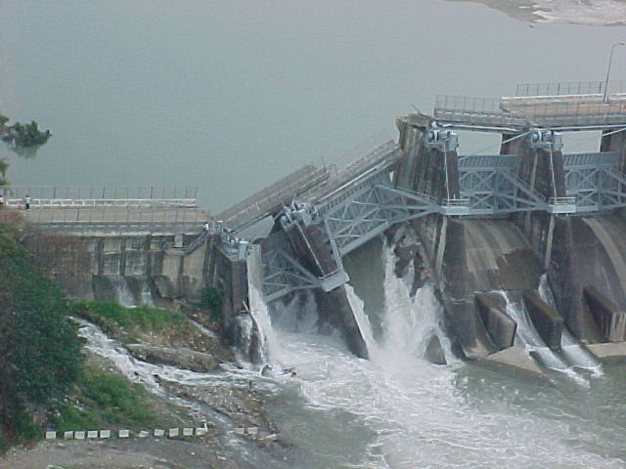
FAULTS ON THE LAND AND UNDERNEATH THE SEA
FAULTING - Rupture leading to earthquakes generally occurs along a fault: the longer the length of the rupture, the greater the total energy release.
AFTERSHOCKS - Following an earthquake, adjustments along a fault commonly generate a series of smaller earthquakes (days to months).

Slide 20
Shihkang Dam, Taiwan

Slide 21
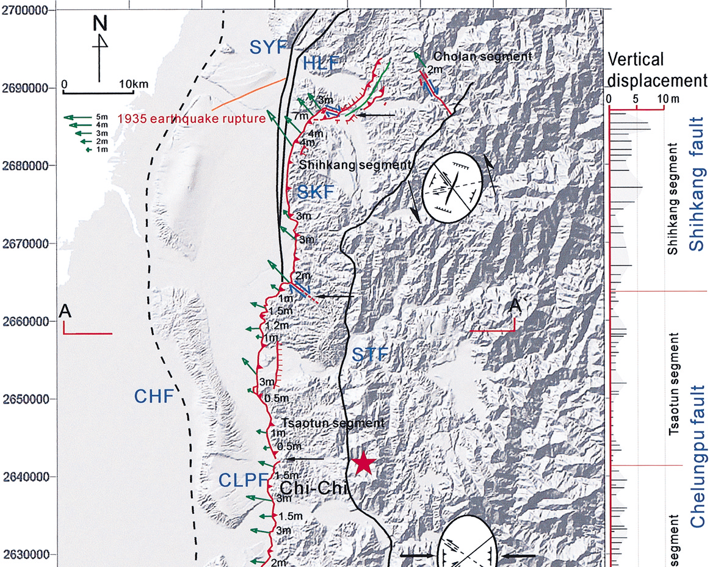
FAULT RUPTURE AT WESTERN MARGIN OF THE FOLD -THRUST BELT (TAIWAN) DURING THE M7.6 1999 CHI CHI EARTHQUAKE

Slide 22
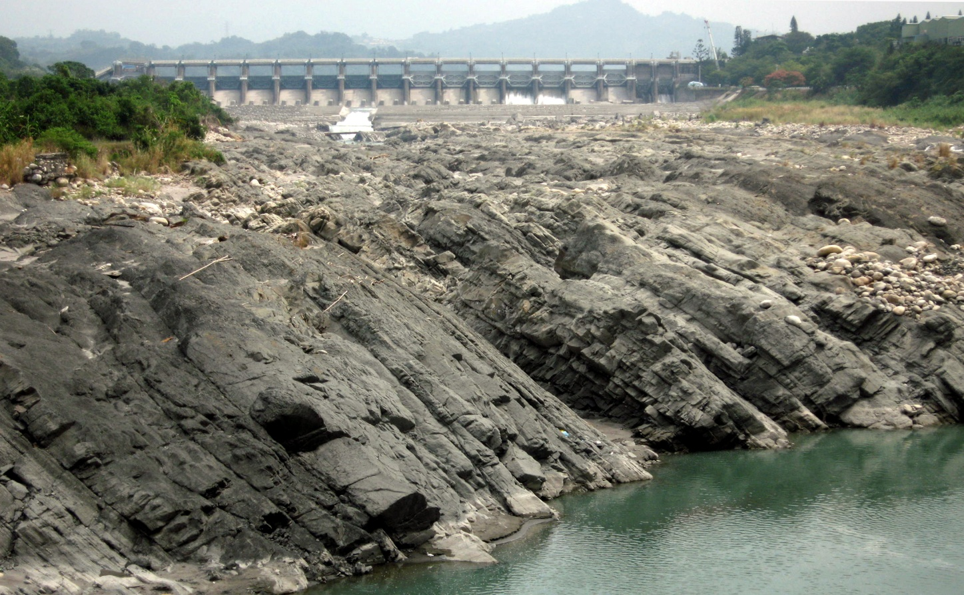
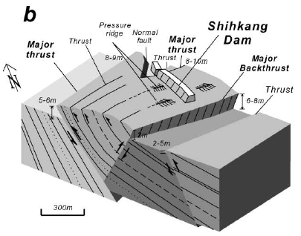
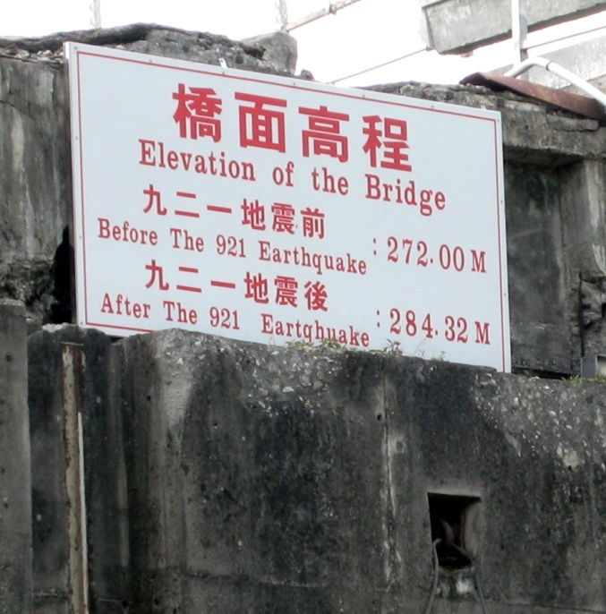
DEFORMATION OF THE SHIHKANG DAM, TAIWAN IN THE M7.6 1999 CHI-CHI EARTHQUAKE

Slide 23
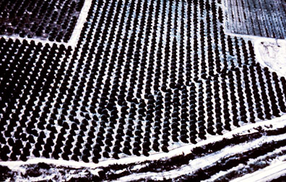
1940 Imperial Valley (California) earthquake ; offset of orange trees

Slide 24
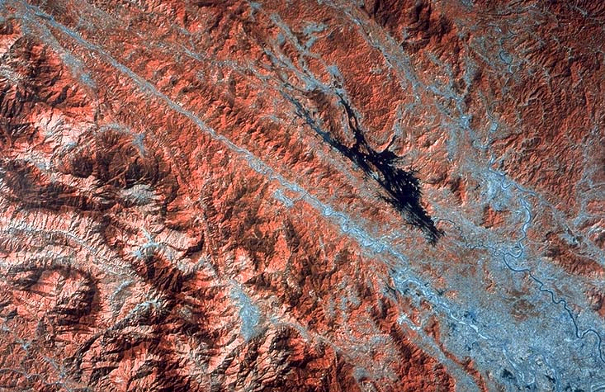
RED RIVER FAULT ZONE, CHINA-VIETNAM

Slide 25
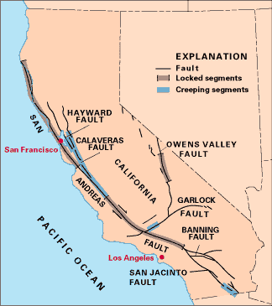
Some segments of a fault store elastic energy for hundreds of years and rupture in great earthquakes
Other segments regularly slip, producing small earthquakes
Some parts of a fault creep slowly with little noticeable seismic activity

Slide 26
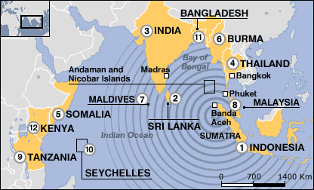
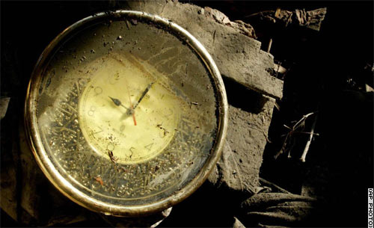
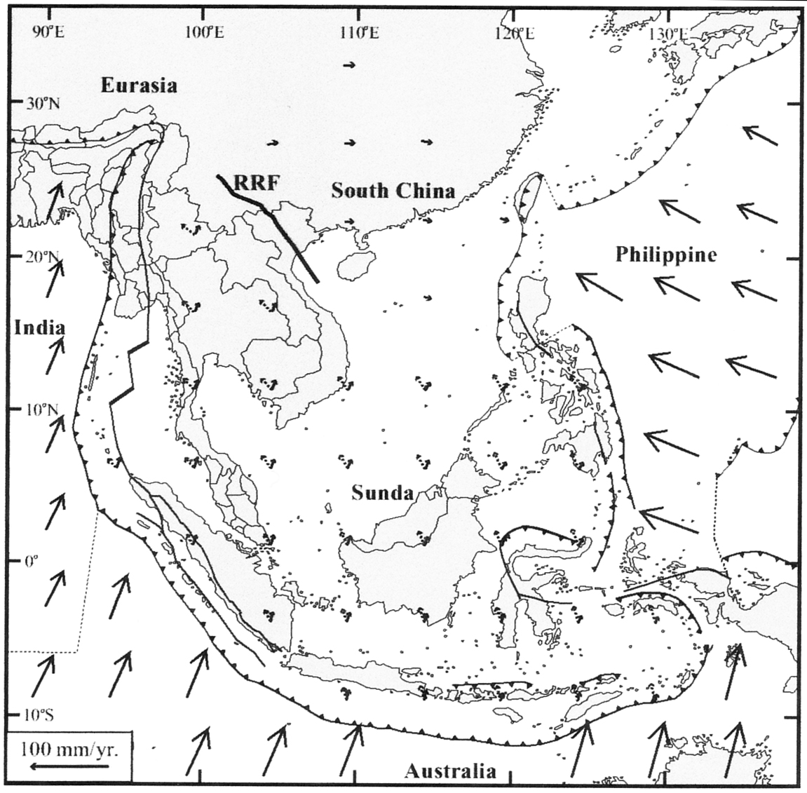
2004 EARTHQUAKE (red dot) AND TSUNAMI
PREVIOUS GREAT MEGATHRUST EARTHQUAKES IN 1797, 1833 (yellow dot) and 1861 (green dot) ALONG SUNDA TRENCH SUBDUCTION ZONE – all generated tsunamis

Slide 27
Bigger Faults Make Bigger Earthquakes
Notes:
Y axis is length of fault
X axis is magnitude of earthquake

Slide 28
Bigger Earthquakes Last a Longer Time
Notes:
Y axis is how many seconds the earthquake lasts
X axis is the magnitude of the earthquake

Slide 29
What Controls the Level of Shaking?
Magnitude
More energy released
Distance
Shaking decays with distance
Local soils
amplify the shaking

Slide 30
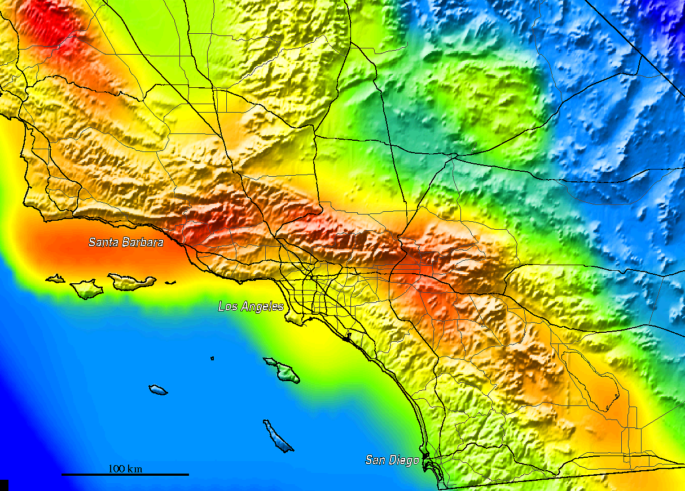
Shaking Hazard in Southern California

Slide 31
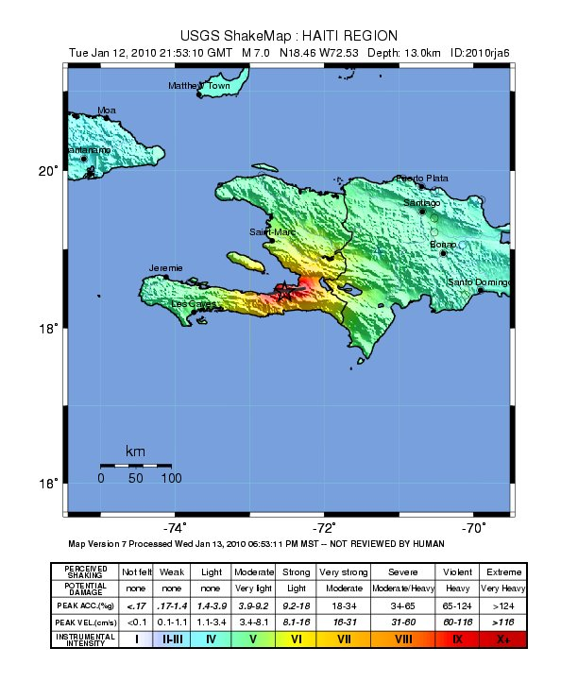

Slide 32
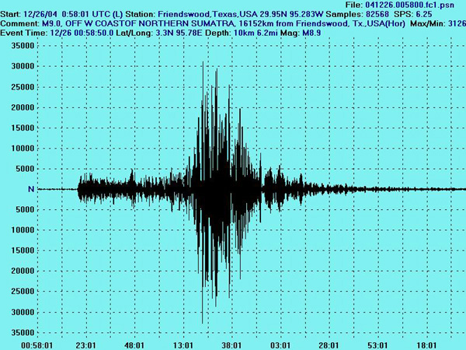
Seismogram of the 2004 Great Sumatra Earthquake

Slide 33
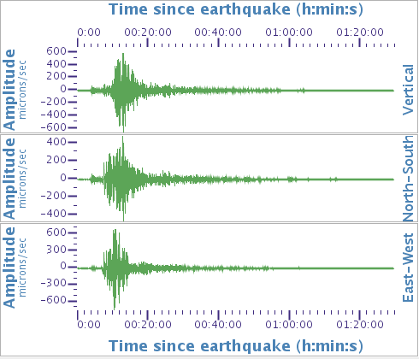
JAN 12 HAITI EARTHQUAKE RECORDED AT JENKINSVILLE, SOUTH CAROLINA

Slide 34
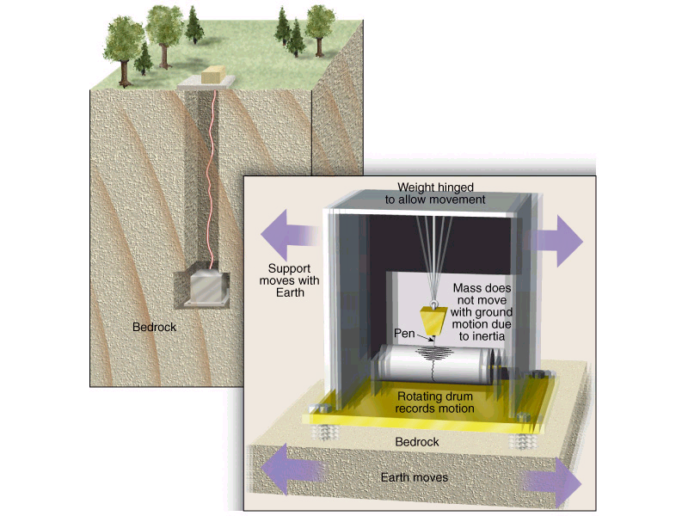
SEISMOLOGY – INSTRUMENTATION 1
Seismograph: designed to record horizontal ground motion.

Slide 35
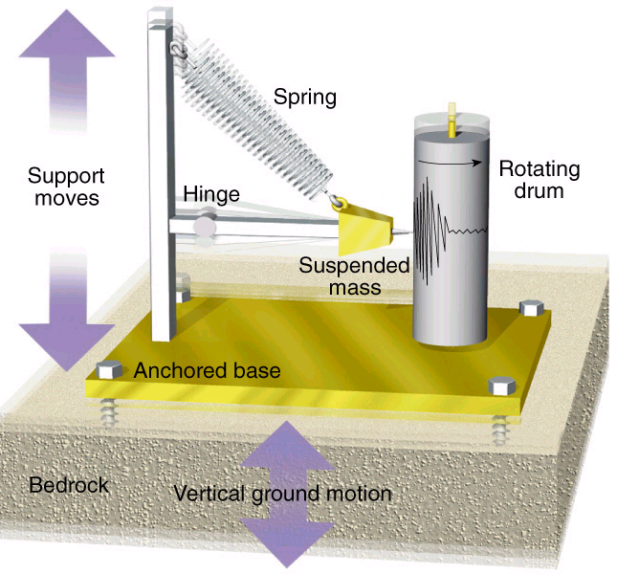
SEISMOLOGY – INSTRUMENTATION 2
Seismograph designed to record vertical ground motion.

Slide 36
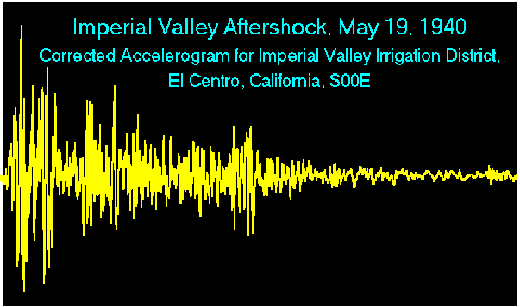
SEISMOLOGY – INSTRUMENTATION 3
ACCELEROGRAPHS MEASURE
OFF-SCALE GROUND MOTION
Strong Motion Accelerograph measures high amplitude seismic waves beyond recording potential of seismographs

Slide 37
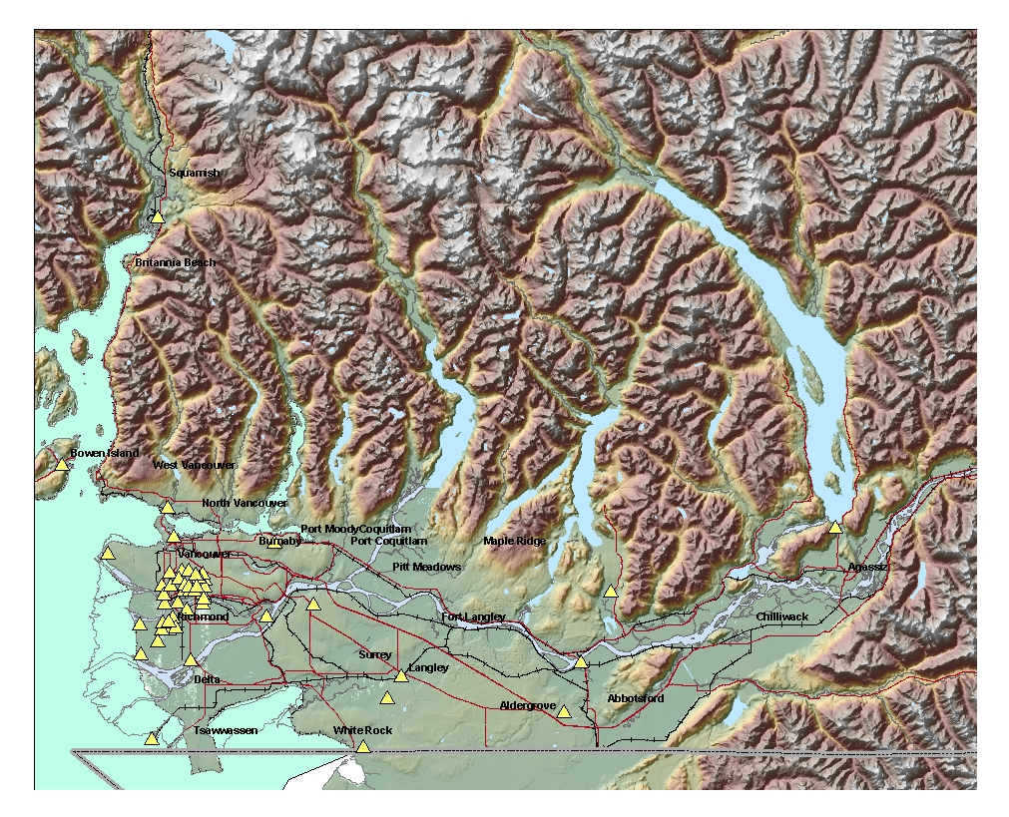
STRONG MOTION NETWORK – GREATER VANCOUVER (NRCan)

Slide 38
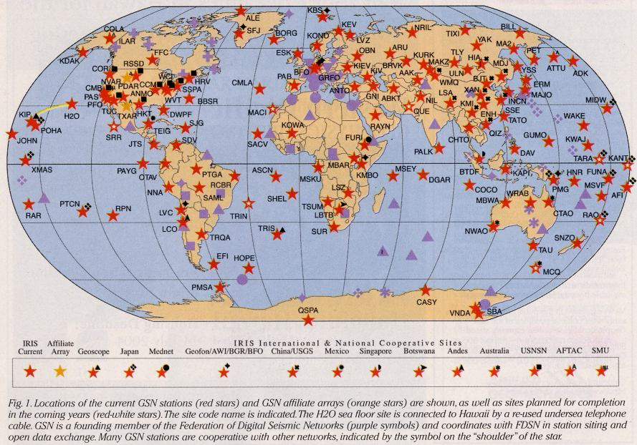
GLOBAL SEISMIC NETWORK

Slide 39
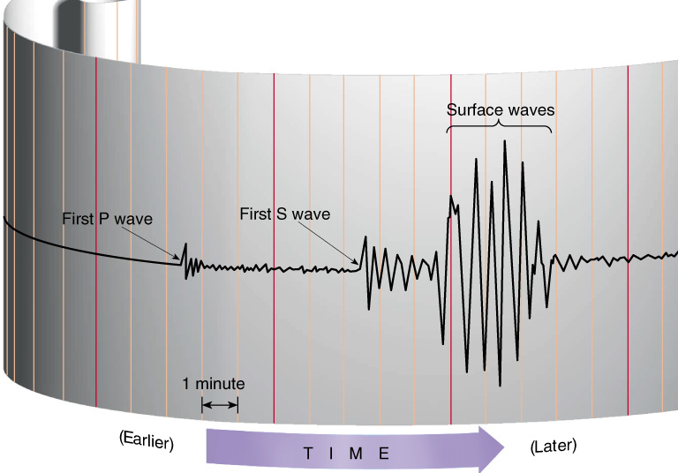
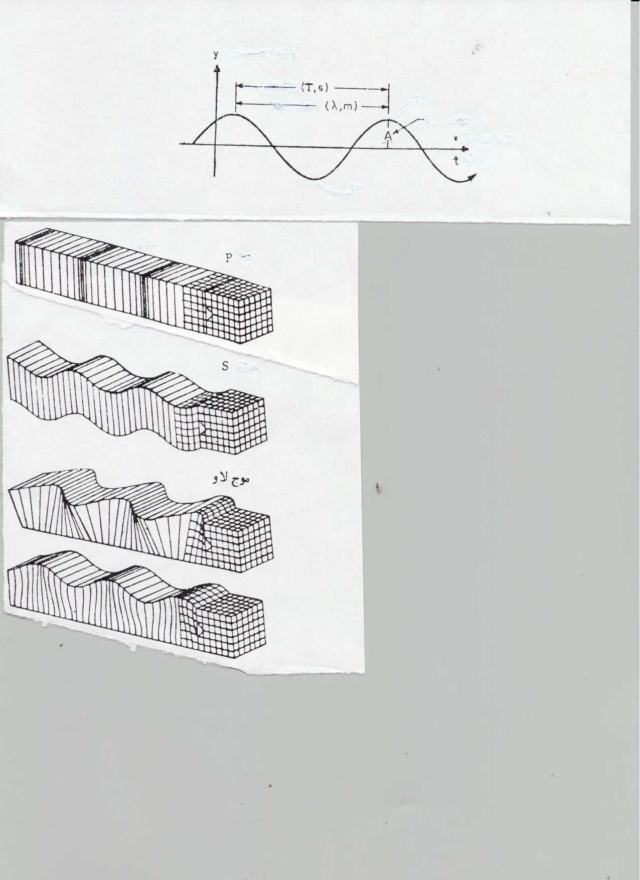
SEISMIC WAVES
When an earthquake occurs, several types of seismic waves radiate out from the focus at the same time.
P-waves are the fastest, they arrive at a seismograph first, followed by S-waves, and then by surface waves. The difference between the arrival times of the P- and S- waves is the P-S time interval: it is a function of the distance of the seismograph station from the focus.
Wavelength
Amplitude

Slide 40
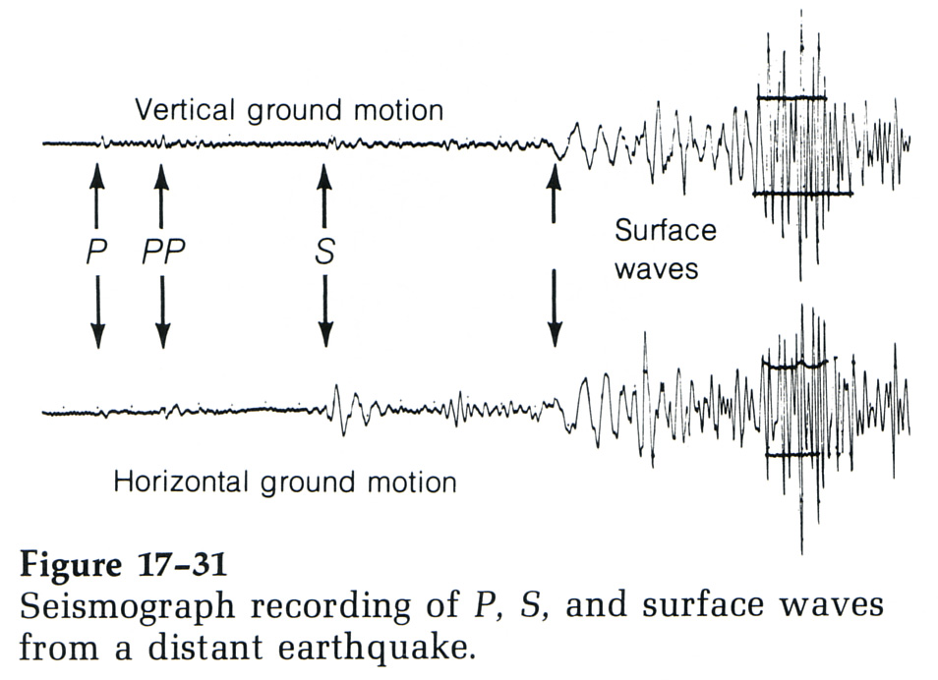
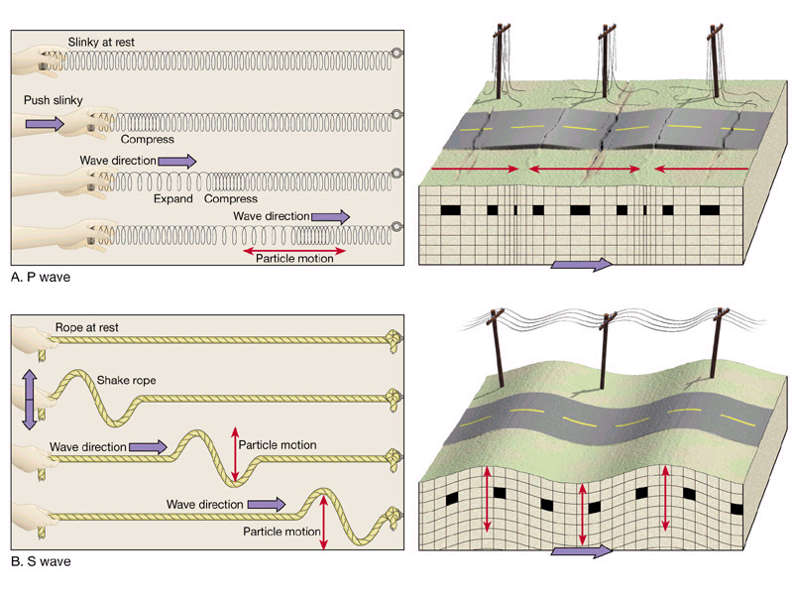
BODY WAVES - S Waves
T&L, fig. 16.9
S-waves or secondary waves: are somewhat slower than P-waves and can only travel through solids. These shear waves move material perpendicular to the direction of travel, thereby producing shear stresses. S-waves cannot travel through liquids, because they have no shear strength.

Slide 41
BODY WAVES - P Waves
T & L 2002
P-waves or primary waves: are the fastest seismic waves, and can travel through solids, liquids and gases. P-waves are compressional, or “push-pull”, moving material back and forth along a line in the same direction that the waves themselves are moving (parallel to direction of travel). Measured at the seismograph after travelling through the Earth’s interior.

Slide 42
BODY WAVES - S Waves
S-waves or secondary waves: are somewhat slower than P-waves and can only travel through solids. These shear waves move material perpendicular to the direction of travel, thereby producing shear stresses. S-waves cannot travel through liquids, because they have no shear strength. Measured at the seismograph after travelling through the Earth’s interior.

Slide 43
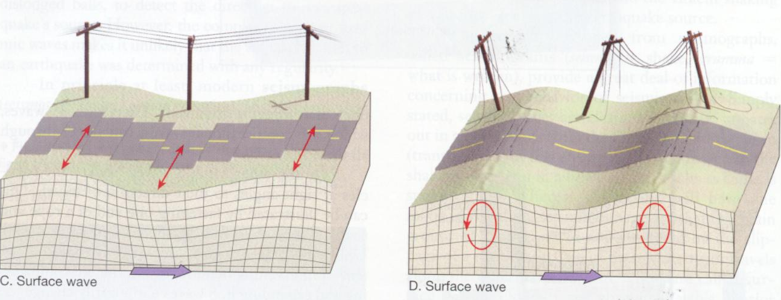
SURFACE WAVES – DESTRUCTIVE COMPONENT
LOVE WAVES
RAYLEIGH WAVES
Surface waves travel along or just below the Earth’s surface, and are slower than body waves.
L-waves (Love waves ) move material back and forth in a horizontal plane perpendicular to the direction of wave movement.
R-waves (Rayleigh waves) move material in an elliptical path within a vertical plane oriented parallel to the direction of wave movement.

Slide 44
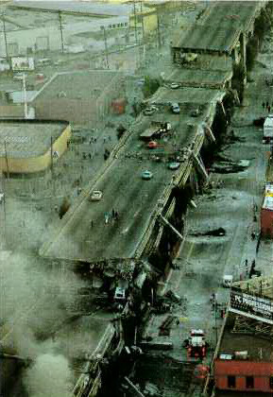

Slide 45
BODY WAVES - S Waves
T&L, fig. 16.9
S-waves or secondary waves: are somewhat slower than P-waves and can only travel through solids. These shear waves move material perpendicular to the direction of travel, thereby producing shear stresses. S-waves cannot travel through liquids, because they have no shear strength.

Slide 46
Seismogram of the 1995 Kobe Earthquake

Slide 47
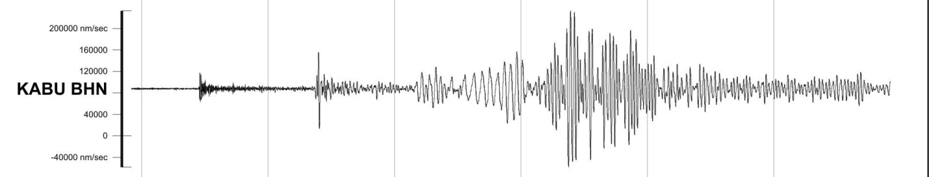
Seismogram of 2010 Haiti Earthquake at station KABU BHN (Katmai, Alaska)

Slide 48
LOCATING THE EPICENTRE OF AN EARTHQUAKE

Slide 49
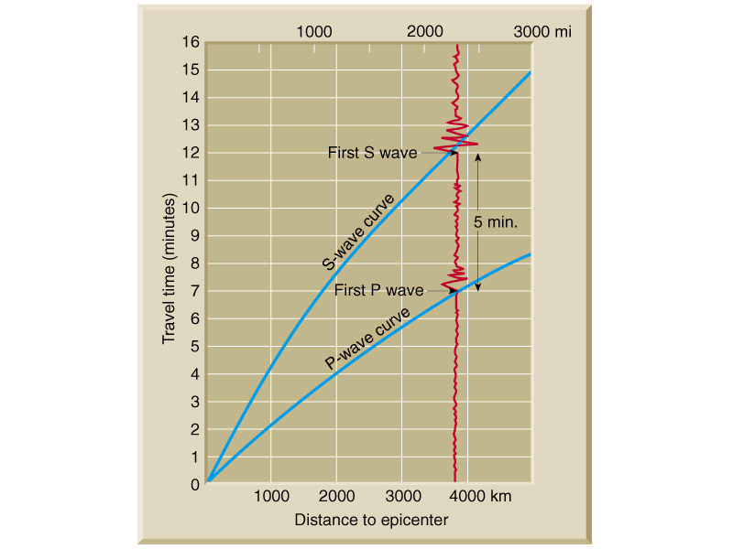
LOCATING THE EPICENTRE OF AN EARTHQUAKE 1
P and S waves travel at different velocities, and so arrive at the seismograph at different times.
Arrival time depends upon the distance between the seismograph and the focus of the event.
A travel-time template is used to determine the distance to the epicenter.
Example with arrival time difference of 5 minutes

Slide 50
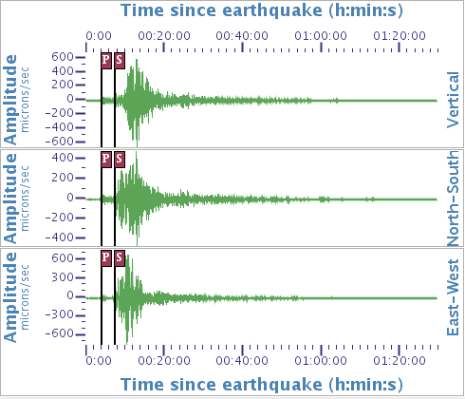
JAN 12 HAITI EARTHQUAKE RECORDED AT JENKINSVILLE, SOUTH CAROLINA

Slide 51
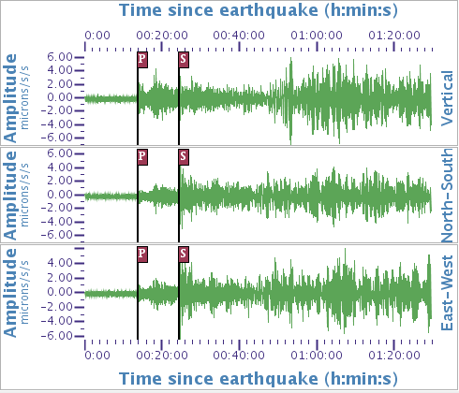
JAN 12 HAITI EARTHQUAKE RECORDED AT AKBULAR, KAZAKHSTAN

Slide 52

LOCATING THE EPICENTRE OF AN EARTHQUAKE - 2
An earthquake epicenter is located using the distances obtained from three or more seismic stations.

Slide 53
EARTHQUAKE MAGNITUDE

Slide 54

EARTHQUAKE MAGNITUDE SCALE
Richter Magnitude Scale
Quantitative estimate of earthquake magnitude (size)
Based on instrumental measurement
Require calculation of total amount of energy released by an earthquake at its source, independent of intensity. Various magnitude scales have been developed (but Richter is basic one)
Log scale, so each whole-number increase in magnitude represents a 10-fold increase in wave amplitude, and approximately a 30-fold increase in the amount of energy released.

Slide 55

Nomograph for estimating Richter Magnitude

Slide 56

Table 4.2
Log E = 11.8 + 1.5M_{L}

Slide 57

ENERGY RELEASE COMPARISONS

Slide 58
EARTHQUAKE INTENSITY

Slide 59


EARTHQUAKE INTENSITY: MODIFIED MERCALLI INTENSITY SCALE
Qualitative description of the effects of an earthquake at a particular location, as evidenced by observed damage and human reactions at that location
Can be used to retroactively estimate magnitude and epicentral location of pre-instrumental earthquakes
Also used to estimate strong ground motion levels in different regions and loss estimation in an earthquake-struck zone
Giuseppe Mercalli
1968 NZ Quake

Slide 60

EARTHQUAKE INTENSITY
Subjective/qualitative measure of damage due to earthquake.
Intensity depends on:
Earthquake Magnitude
Distance from epicenter
Focal depth of earthquake
Foundation materials
Type of building construction
Duration of shaking
Modified Mercalli Intensity Scale

Slide 61

Table 4.4

Slide 62

Fig. 4.27
Contour map of Mercalli Intensities (isoseismal map) from the 1971 M6.6 San Fernando Earthquake, CA

Slide 63


Slide 64

Peak Ground Acceleration (PGA) – a measure of the amplitude of ground shaking measured in accelerographs (STRONG MOTION DATA)

Slide 65
EARTHQUAKE INTENSITY: MODIFIED MERCALLI INTENSITY SCALE
Qualitative description of the effects of an earthquake at a particular location, as evidenced by observed damage and human reactions at that location
Can be used to retroactively estimate magnitude and epicentral location of pre-instrumental earthquakes
Also used to estimate strong ground motion levels in different regions and loss estimation in an earthquake-struck zone
Giuseppe Mercalli
1968 NZ Quake

Slide 66
EARTHQUAKE DAMAGE AND MITIGATION

Slide 67

MODES OF BUILDING DAMAGE DURING EARTHQUAKES
STRUCTURAL FAILURE INDUCED BY SHAKING - SHAKING MAY BE AMPLIFIED BY FOUNDATION SOILS BUT NO GEOTECHNICAL FAILURE OCCURS
FOUNDATION FAILURE INDUCED BY SEISMIC SHAKING – GEOTECHNICAL FOUNDATION FAILURE OCCURS BUT BUILDINGS “UNDAMAGED” BY STRUCTURAL FAILURE

Slide 68

Ground Shaking and Damage
Ground shaking results in the most damage during an earthquake (primary = building collapse; secondary = liquefaction, landslides).
Earthquake magnitude, distance from the epicentre, site geology and building construction techniques are factors that control damage.
The amplitude and duration of seismic waves generally increase as they pass from bedrock to poorly consolidated or water-saturated material (amplification). Thus, structures built on these materials typically suffer greater damage than similar structures built on bedrock because they experience greater shaking.

Slide 69

GROUND SHAKING AND BUILDING RESONANCE
Buildings with natural periods of 2 sec were more susceptible
Mexico earthquake, 1985

Slide 70

2003 BAM EARTHQUAKE, IRAN - 2000 yr old citadel of Bam (Pre-Earthquake View)

Slide 71

2003 BAM EARTHQUAKE, IRAN - 2000 yr old citadel of Bam (Post-Earthquake View)

Slide 72

ATTENUATION AND AMPLIFICATION
Attenuation mainly depends on:
Distance to epicenter
Focal depth
Amplification depends on:
Distance to epicenter
Soil type (in lake deposit 2 to 3 times more than sand and gravels)
Soil thickness (the thicker the soil the larger the amplification)
Depth of foundation (shallow foundations experience higher acceleration).
Amplification can be measured

Slide 73

COMPARISON OF PEAK GROUND ACCELERATION AT PORT-AU-PRINCE AND CONCEPCION USING ATTENUATION RELATIONS (Haiti M7.0; Chile M8.8)
ATTENUATION

Slide 74

GROUND SHAKING & AMPLIFICATION
1989 Loma Prieta Earthquake (M7.1)

Slide 75

Collapse of Cypress Freeway, Oakland, Loma Prieta Earthquake, California, 1989

Slide 76


EARTHQUAKE SITE EFFECTS IN MEXICO CITY
Seismic shaking amplification due to loose sediments

Slide 77


SPANISH CONQUEST OF TENOCHTITLAN IN 1521

Slide 78

MEXICO CITY

Slide 79

Mexico City

Slide 80


MEXICO CITY – COMPLEX FOUNDATIONS FOR NEW BUILDINGS AND SETTLEMENT OF HERITAGE STRUCTURES
Metropolitan Cathedral – dates from about 1600

Slide 81



Slide 82



1985 MICHOACAN EARTHQUAKE (M8.0), MEXICO
Resulted in great damage to buildings in Mexico City
At least 9,500 deaths
Amplification effects very important

Slide 84


2017 MEXICO EARTHQUAKES 2
M 7.1 (September 19 2017).
At least 44 buildings collapsed in Mexico City.
At least 375 deaths.
Exactly 32 years after the M8.0 Great Mexico City Earthquake of 1985 in which about 5,000 people lost their lives

Slide 85


Headline from Time Magazine September 23, 2017

Slide 86


Slide 87


Slide 88

1985 M8.0 Mexico City Earthquake resulted in 5,000 deaths mostly in building collapse. A landmark event in engineering seismology.

Slide 89



1976 TANGSHAN EARTHQUAKE (M 7.4)
90% OF BUILDINGS COLLAPSED IN TANGSHAN
255,000 – 650,000 DEATHS

Slide 90

TANGSHAN IN 2008

Slide 91



GUJURAT EARTHQUAKE, INDIA 2001
M 7.7
20,000 deaths
Extensive liquefaction

Slide 92


Slide 93






87,350 deaths

Slide 94



RUINS OF BALAKOT, PAKISTAN, 2005

Slide 95


MAY 2008 EAST SICHUAN EARTHQUAKE (M7.9), CHINA
5.36 M buildings collapsed (88,000 deaths)
Earthquake triggered many thousands of landslides
Some formed landslide dams and formed extensive lakes which threatened communities downstream

Slide 96
EARTHQUAKE
RESISTANCE
DAMAGE/LOSS

Slide 97

IMPROVE SEISMIC RESISTANCE OF ADOBE BUILDINGS – CENTRAL & SOUTH AMERICA

Slide 98

Inadequately braced house failed due to horizontal acceleration – 1971 San Fernando Earthquake, California (M 6.6) – lack of stiffness

Slide 99



Fig. 4.37
Some structural measures for earthquake resistance – North America

Slide 100



LOSS PATTERNS (AGE AND SITE CONDITIONS) AND LOSS PREVENTION (INCREASE IN STIFFNESSS) IN BUILDINGS

Slide 101

Fig. 4.33
6 story building with braced frame

Slide 102

DAMAGE IN CENTRAL CHRISTCHURCH, FEBRUARY 2011

Slide 103
9 February 2012: Intense ground shaking, non-ductile columns and the asymmetrical layout of shear walls were the critical factors contributing to the collapse of the CTV building during the 22 February 2011 Christchurch earthquake.
The Government ordered the investigation in March 2011, along with investigations into the failure of the Pyne Gould Corporation, Forsyth Barr, and Hotel Grand Chancellor buildings, following the 22 February 2011 6.3 magnitude earthquake, which claimed the lives of 184 people, including 115 in the CTV building.
The comprehensive investigations included eye witness accounts, photographs, site examinations, sampling and testing of materials, structural analysis and testing of various hypotheses using established engineering models.
Three critical factors were found that contributed to the building’s collapse:
Intense horizontal ground shaking.
Lack of ductility in the columns, making them brittle.
Asymmetrical layout of the shear walls, making the building twist during the earthquake, placing extra strain on the columns.
The ductility of the columns (and strength) and the asymmetrical layout of the shear walls were found to have not met the building standards of the day (1986).
Other factors that may have contributed to the CTV collapse included: 1) Low concrete strengths in some of the critical columns, 2) Exceptionally high vertical ground movement, 3) Possible interaction of columns and concrete spandrel panels (on the external face of the building), making the columns less flexible, 4) Separation of floor slabs from the north core of the building, 5) Structural influence of the concrete masonry walls, making lower floors more rigid than upper floors, which placed additional stress on the upper columns during the earthquake.
The common denominator in all collapse scenarios identified by the Expert Panel was the failure of one or more columns on the east face of the building. This is consistent with eye-witness accounts of the building during the earthquake.
Current building requirements are more stringent now than in the 1980s when the CTV building was constructed. Standards have progressively improved over time as more is understood about how buildings respond in earthquakes.

Slide 104
EARTHQUAKE
RESISTANCE
DAMAGE/LOSS

